Slide 1
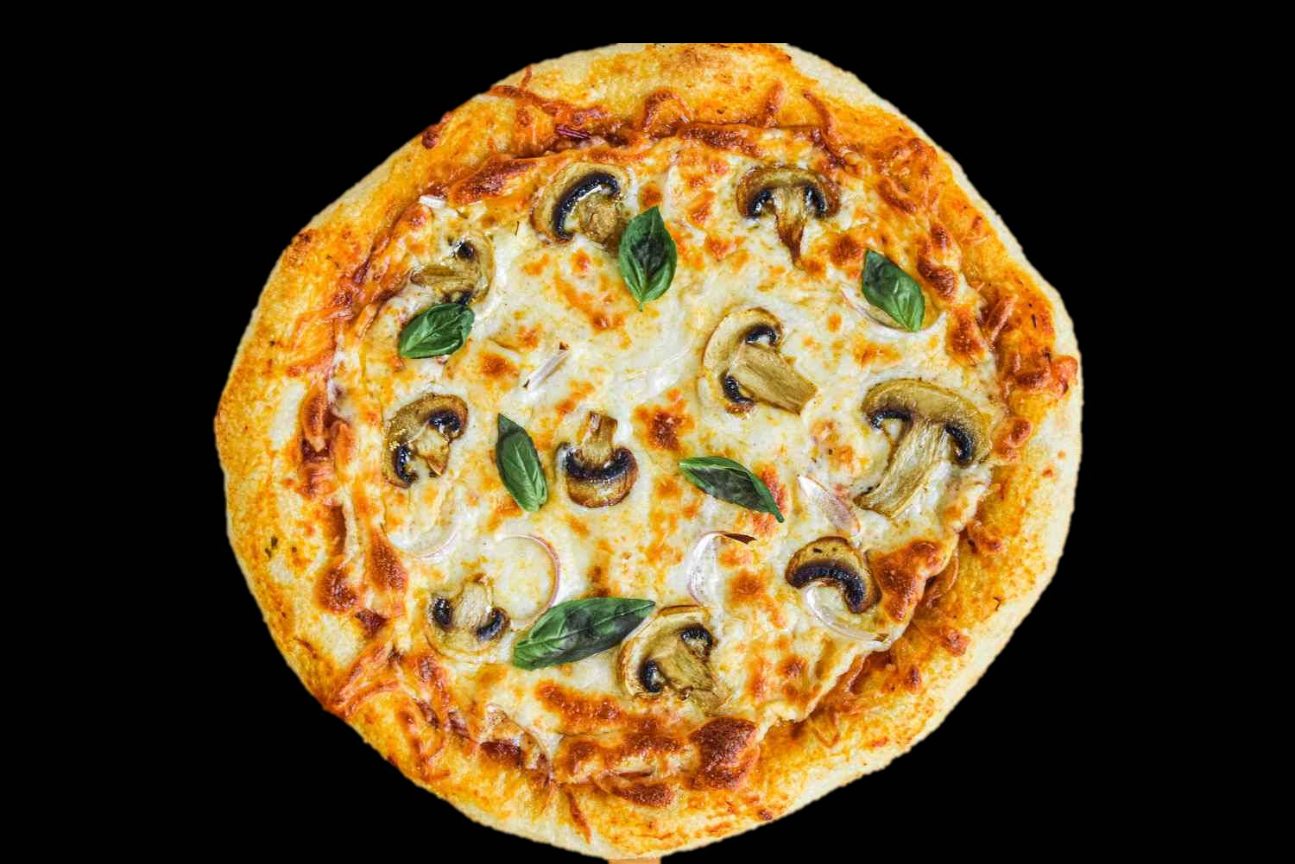



The Great
Pizza Analytics
Challenge​​
SQL-Based Data Analysis Mini
Project By Asha Maddi​

Slide 2
The Great
Pizza Analytics
Challenge​​
SQL-Based Data Analysis Mini
Project By Asha Maddi​

Slide 3



The Great
Pizza Analytics
Challenge​​
Agenda
Overview of Key Phases and Insights
Data Exploration
SQL Analysis
Business Insights
In this phase, we will focus on analyzing the dataset, identifying trends, and uncovering meaningful insights that will guide our SQL analysis and business decision-making.
This section emphasizes applying SQL queries to extract, manipulate, and aggregate data, allowing us to derive actionable insights from our dataset for informed business strategies.
We will interpret the results from our analysis, discussing their implications and how they can influence decision-making processes, ultimately driving growth and innovation in our pizza analytics challenge.
SQL-Based Data Analysis Mini
Project By Asha Maddi​

Slide 4

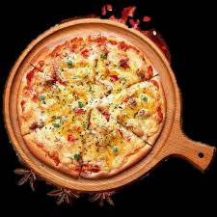
The Great
Pizza Analytics
Challenge​​
PHASE 1: Foundation & Data Inspection
Begin by installing the database and conducting essential quality checks to verify its integrity. During this phase, it is crucial to explore unique categories within the dataset, such as different types of pizzas and their respective attributes— Pay particular attention to handling any missing data, as incomplete records can skew analysis results. It's also important to identify and address any records that lack pricing information, as this is a critical component for most analyses involving sales or profitability. By carefully preparing the dataset through these steps, you set a solid foundation for accurate and reliable analysis in the subsequent stages of your project.
SQL-Based Data Analysis Mini
Project By Asha Maddi​

Slide 5
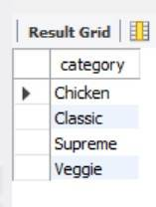
Q1.List all unique pizza categories (DISTINCT).
SELECT DISTINCT category from pizza_types;;

Slide 6
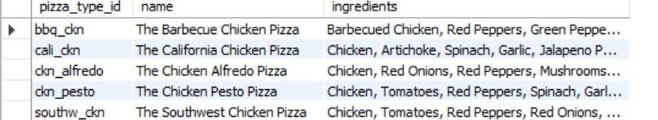
Q2: Display pizza_type_id,name and ingredients, replacing NULL ingredients withMissing Data", Show first 5 rows.
SELECT pizza_type_id, name, COALESCE(ingredients, 'Missing Data') AS ingredients FROM pizza_types LIMIT 5;
sdd

Slide 7
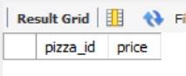
Q3: Check for pizzas missing a price (IS NULL).
SELECT pizza_id ,price
from pizzas WHERE price IS NULL;
sdd

Slide 8

📊 PHASE 2: Filtering & Exploratory SQL Analysis
SQL filtering techniques help answer business questions by extracting orders based on dates and times. Filtering pizzas by size, keyword, and price range tailors offerings, enhancing satisfaction and profitability. This sharpens your skills in refining datasets and conducting analyses.
sdd

Slide 9
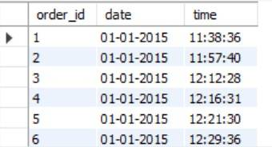
Q1: Orders placed on ‘2015-01-01'
SELECT * from orders WHERE date = '01-01-2015';
sdd

Slide 10
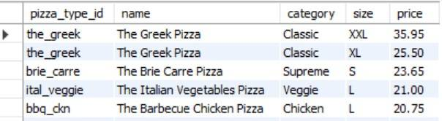
Q2: List pizzas with price descending.
SELECT pt.pizza_type_id,pt.name,pt.category,p.size,p.price FROM pizza_types AS pt LEFT JOIN pizzas AS p ON pt.pizza_type_id=p.pizza_type_id
ORDER BY p.price desc;
sdd

Slide 11
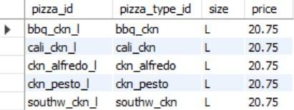
Q3: Pizzas sold in sizes ‘L' or 'XL'
SELECT * FROM pizzas WHERE size IN('L','XL');
sdd

Slide 12
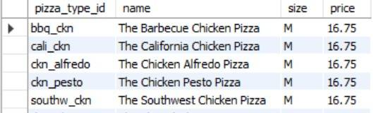
Q4: Pizzas priced between $15.00 and $17.00.
SELECT pt.pizza_type_id,pt.name,p.size,p.price FROM pizza_types AS pt LEFT JOIN pizzas AS p ON pt.pizza_type_id=p.pizza_type_id
WHERE price BETWEEN 15.00 AND 17.00;
sdd

Slide 13
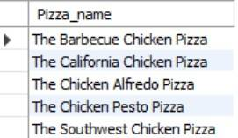
Q5: Pizzas with "Chicken" in the name.
SELECT name AS Pizza_name from pizza_types WHERE name LIKE '%Chicken%';
sdd

Slide 14
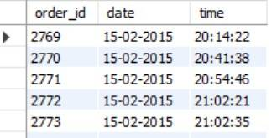
Q6: Orders on '2015-02-15' or placed after 8 PM.
SELECT * from orders
WHERE DATE = '15-02-2015' AND time >'20:00:00';
sdd

Slide 15
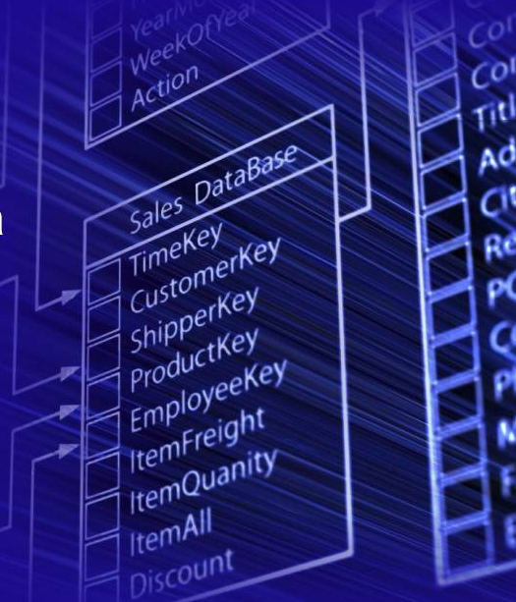
📈 PHASE 3: Sales Performance & Business Insights
SQL queries are vital for extracting insights from sales data. You calculate total sales and analyze category performance to identify which product categories contribute most.
Detecting pizzas that were never ordered uncovers menu gaps for optimization.
sdd

Slide 16
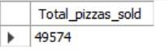
Q1:Total quantity of pizzas sold (SUM).
SELECT SUM(quantity) AS Total_pizzas_sold FROM order_details;
sdd

Slide 17
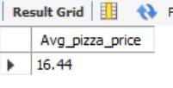
5
Q2: Average pizza price (AVG).
SELECT
ROUND(AVG(price),2) AS Avg_pizza_price FROM pizzas;
sdd

Slide 18
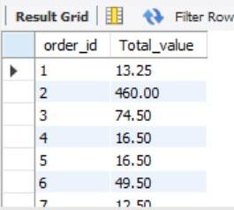
Q3: Total order value per order (JOIN, SUM, GROUP BY).
SELECT od.order_id, SUM(od.quantity)*SUM(p.price) AS Total_value FROM Pizzas p JOIN order_details od
ON od.pizza_id=p.pizza_id GROUP BY od.order_id ORDER BY order_id;
sdd

Slide 19
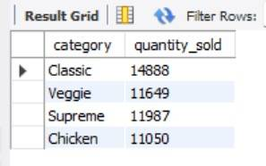
Q4: Total quantity sold per pizza category (JOIN, GROUP BY).
SELECT DISTINCT pt.category, SUM(od.quantity) AS quantity_sold FROM pizzas p JOIN order_details od ON p.pizza_id=od.pizza_id
JOIN pizza_types pt ON pt.pizza_type_id=p.pizza_type_id GROUP BY pt.category;
sdd

Slide 20
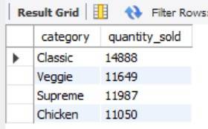
Q5: Categories with more than 5,000 pizzas sold (HAVING).
SELECT DISTINCT pt.category, SUM(od.quantity) AS quantity_sold FROM pizzas p JOIN order_details od ON p.pizza_id=od.pizza_id
JOIN pizza_types pt ON pt.pizza_type_id=p.pizza_type_id GROUP BY pt.category
HAVING quantity_sold > 5000;
sdd

Slide 21
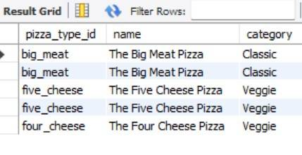
Q6: Pizzas never ordered (LEFT/RIGHT JOIN).
SELECT pt.pizza_type_id, pt.name ,pt.category FROM pizza_types pt LEFT JOIN pizzas p
ON pt.pizza_type_id=p.pizza_type_id LEFT JOIN order_details od ON p.pizza_id=od.pizza_id
WHERE od.pizza_id IS NULL;
sdd

Slide 22
Q7: Price differences between different sizes of the same pizza
(SELF JOIN).
SELECT p1.pizza_type_id, p1.size AS from_size,
p2.size AS to_size, ABS(p1.price - p2.price) AS price_difference
FROM pizzas p1 JOIN pizzas p2
ON p1.pizza_type_id = p2.pizza_type_id AND p1.pizza_id < p2.pizza_id
ORDER BY price_difference DESC;
sdd

Slide 23
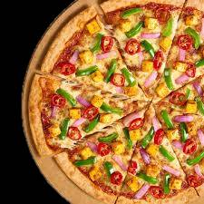
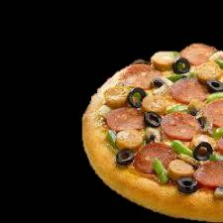
Thank You
For your attention and interest

Slide 24
Thank You
For your attention and interest

